Slide 1

Google Cloud Platform

Slide 2
Google Cloud Platform
Google Cloud Platform (GCP)
Before we begin with what is Google Cloud Platform, why use GCP, what it offers, just think through the challenges that we face using traditional infrastructure.
Challenges like,
What do we during a disaster?
How are we catering to ever growing ecosystem/demand
Maintenance and house-keeping for a datacentre
Keeping a fool-proof system
Handling security of the system
What is Cloud?
How is Cloud Computing changing the world?

Slide 3
Introduction
Cloud Platform
A Cloud is a comprehensive platform providing services that support application development and hosting. The services offered by a cloud platform may be categorized into fundamental services and higher level services. The higher level services are built on top of the fundamental layer.
The fundamental services offered by Amazon and Google Cloud platforms are:
Compute
Storage
Networking
Databases

Slide 4
Cloud Computing
Cloud computing is defined as the services offered through remote servers on the internet. These services might include database storage, applications, compute power and other IT resources over the pay-as-you-go pricing approach. The remote server allows users to save, modify, or process data on the internet or cloud-based platform instead of storing it on a local server or their devices.
Cloud computing is evolving due to fast performance, better manageability, and less maintenance. It helps organizations to minimize the number of resources and overall infrastructure costs. Additionally, it helps IT teams better focus on the important applications, services, and processes and achieve the company's goals.
Typically, the cloud-computing providers offer their services according to the following three standard models:
Platform as a Service (PaaS)
Software as a Service (SaaS)
Infrastructure as a Service (IaaS)

Slide 5
Cloud Computing
There are certain services and models working behind the scene making the cloud computing feasible and accessible to end users. Following are the working models for cloud computing:
Deployment Models
Service Models
Deployment Models
Deployment models define the type of access to the cloud, i.e., how the cloud is located? Cloud can have any of the four types of access: Public, Private, Hybrid, and Community.

Slide 6
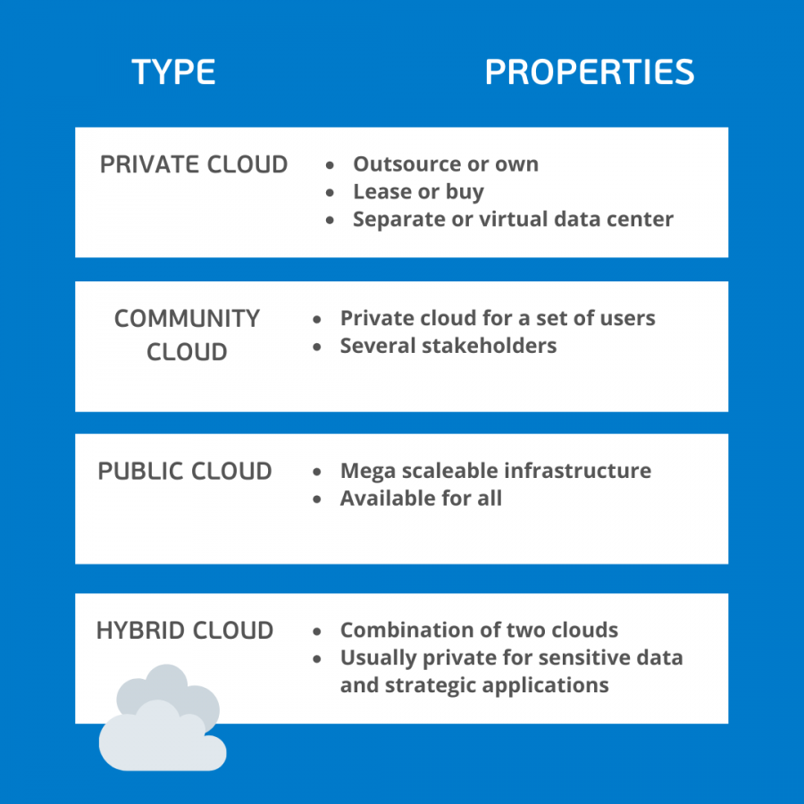
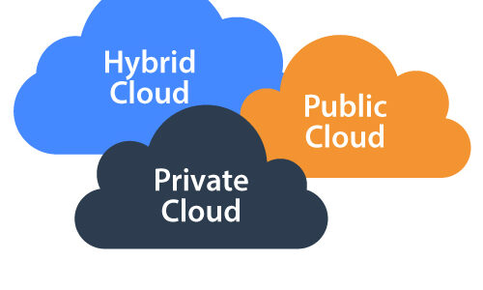
Cloud Computing

Slide 7
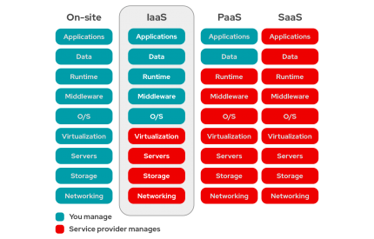
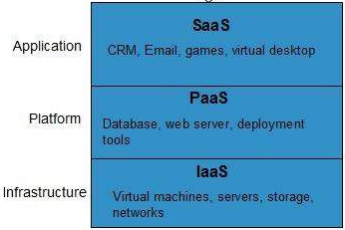
Service Models

Slide 8
Cloud Computing
Now, “Cloud is a collection of servers and computers connected by a network which is owned by a third party vendor somewhere on the globe“
Cloud made sure following things were taken care of:
Utmost care of Data Security by implementing stringent policies
Ensures use of Dynamically Scalable Servers
Provide you with Fast Computation and Remote Access to devices
Flexible Pricing ensures high Cost Optimization
Thus Cloud emerged as a savior and with it we saw different Cloud Service Providers like Google Cloud Platform, Amazon Web Services, Microsoft Azure etc. make their mark in the Cloud domain.

Slide 9
GCP Account Setup
Let's start with the steps of creating a free tier account on Google Cloud Platform:
Step 1: First, we are required to navigate to the following link: https://cloud.google.com/gcp/
Step 2: On the next screen, we need to click on 'Get started for free’
Step 3: Next, we are required to login to the Google Account
On the next screen, we have to enter some necessary details such as name and address details. Also, we have to enter payment details like the method of payments and credit card details. After filling all the details, we need to click on the button 'START MY FREE TRIAL’
On the next screen, we must click on the 'GO TO CONSOLE' button

Slide 10
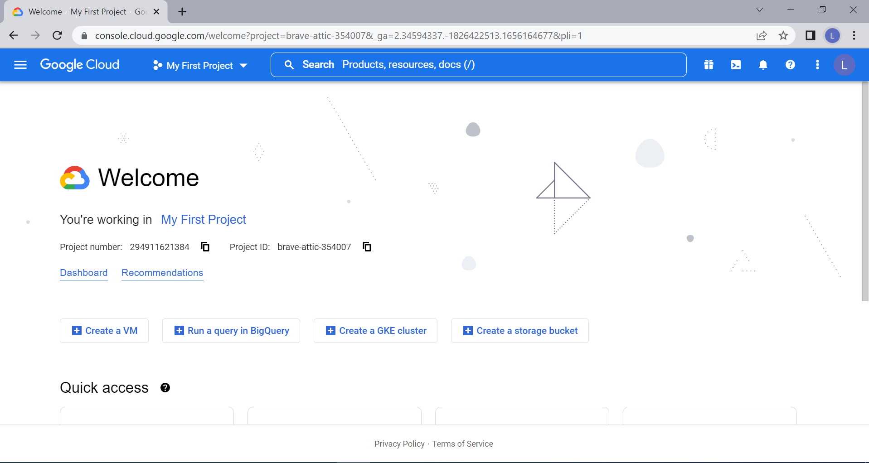
Google Cloud Platform

Slide 11
Types of Google Account
Google Cloud Platform (GCP)
Google Cloud Platform provides infrastructure as a service, platform as a service, and serverless computing environments as a individual account.
Google Workspace
Google Workspace plans provide a custom email for your business and include collaboration tools like Gmail, Calendar, Meet, Chat, Drive, Docs, Sheets, Slides, Forms, Sites and more
Google Workspace business solutions seamlessly integrate everything that you and your team need to get anything done, all-in-one place, including professional @yourcompany email.

Slide 12
Regions and Zones
Region – Physical Datacenter
Regions are collections of zones. Zones have high-bandwidth, low-latency network connections to other zones in the same region. In order to deploy fault-tolerant applications that have high availability,
Zone – within Region
A zone is a deployment area for Google Cloud resources within a region. The fully-qualified name for a zone is made up of <region>-<zone>. For example, the fully qualified name for zone a in region us-central1 is us-central1-a.
Depending on how widely you want to distribute your resources, create instances across multiple zones in multiple regions for redundancy.
Zones should be considered a single failure domain within a region. To deploy fault-tolerant applications with high availability and help protect against unexpected failures, deploy your applications across multiple zones in a region.
Global – Global IIT
The whole infrastructure of your application/product.

Slide 13
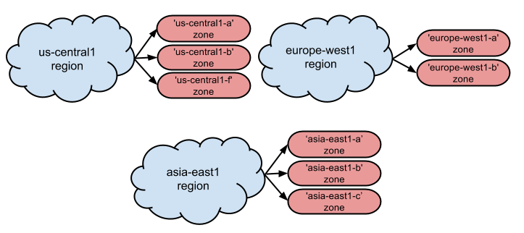
Regions and Zones
The following is a list of available regions and zones.
Region | Available zones | Supported processor types
US | us-central1-a us-central1-b | Sandy Bridge
 | us-central1-f | Ivy Bridge
Europe | europe-west1-a europe-west1-b | Sandy Bridge
Asia | asia-east1-a asia-east1-b asia-east1-c | Ivy Bridge

Slide 14
Resource Hierarchy
The purpose of the Google Cloud resource hierarchy is two-fold
Provide a hierarchy of ownership, which binds the lifecycle of a resource to its immediate parent in the hierarchy.
Provide attach points and inheritance for access control and organization policies.

Slide 15
Resource Hierarchy
Google Cloud Resources
Everything that is being used on Google Cloud Platform is said to be resources. All the Google cloud resources are organized hierarchically like parent-child relationships. In the hierarchy organization node is the root node, projects are the children of the organization, and the other resources are descendants of the projects.
You can set Cloud Identity and Access Management (Cloud IAM) policies at different levels of the resource hierarchy and the resources inherit the policies applied at the parent level. Each resource has exactly one parent.
Google Cloud Resources Lifecycle
The fundamental components that make up all Google Cloud services are said to be resources. Examples: Compute Engine Virtual Machines (VMs),Cloud Storage buckets, App Engine instances, Pub/Sub topics.

Slide 16
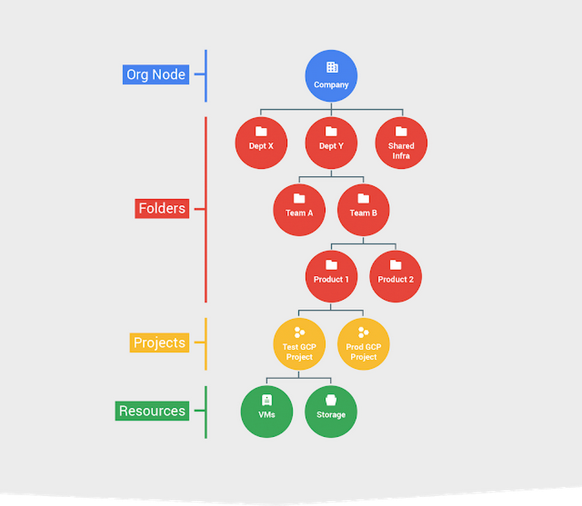
Resource Hierarchy
Four Pillars Of Google Cloud Resources
Organization
Folders
Projects
Resources

Slide 17
Google Cloud Platform
Google Cloud Platform (GCP)
Before we begin with what is Google Cloud Platform, why use GCP, what it offers, just think through the challenges that we face using traditional infrastructure.
Challenges like,
What do we during a disaster?
How are we catering to ever growing ecosystem/demand
Maintenance and house-keeping for a datacentre
Keeping a fool-proof system
Handling security of the system
What is Cloud?
How is Cloud Computing changing the world?

Slide 18
Projects
Google Cloud Platform (GCP)
Before we begin with what is Google Cloud Platform, why use GCP, what it offers, just think through the challenges that we face using traditional infrastructure.
Challenges like,
What do we during a disaster?
How are we catering to ever growing ecosystem/demand
Maintenance and house-keeping for a datacentre
Keeping a fool-proof system
Handling security of the system
What is Cloud?
How is Cloud Computing changing the world?

Slide 19
Cloud SDK - gcloud
Google Cloud Platform (GCP)
Before we begin with what is Google Cloud Platform, why use GCP, what it offers, just think through the challenges that we face using traditional infrastructure.
Challenges like,
What do we during a disaster?
How are we catering to ever growing ecosystem/demand
Maintenance and house-keeping for a datacentre
Keeping a fool-proof system
Handling security of the system
What is Cloud?
How is Cloud Computing changing the world?

